Slide 1

https://www.uni-goettingen.de/en/48115.html
Chapter 9 of <Breeding Method>
UNPLAB-BrMeth_Ch9[TheFour II]

Slide 2
Sequential Number: #27
UNPLAB-BrMeth_Ch-9[TheFour II]
Unless I explicitly state otherwise, images and cartoons are created using ChatGPT.
You may use this material free of charge under the terms of the CC BY license. This requires that you provide appropriate attribution to the author: W. Link, University of Goettingen, Germany.
In a few cases, individual images, photographs, or similar material may be subject to a more restrictive Creative Commons license. Where this applies, it is explicitly indicated, and you must comply with the stated license terms for those items.
Please check the license information carefully before reuse. Responsibility for complying with the applicable license terms rests entirely with you.
2

Slide 3
You already know:
Population Genetics. Genotype frequency, Allele frequency, Hardy-Weinberg-Equilibrium, Inbreeding coefficient, Kinship, Selection, Drift, Migration, Mutation, GxE, heritability, Breeder’s Equation.
And you have already studied Recurrent Selection (that already gave you a good feeling for what Methodology is, yet, in Recurrent Selection which is Pre-Breeding, Vorlaufzüchtung).
You already have seen the Pedigree Selection Method, one of the methods in the Category of Line Breeding (Development of Line Cultivars).
Keywords of this chapter: Pedigree Method; Bulk Method; Partial Bulk Method; Single-Seed-Descent Method;
Doubled Haploid Method. Speed Breeding. Inducer.
Algebra as introduced in this chapter: none
3

Slide 4
These Methods are presented here (Category Line Breeding):
Pedigree Method (without and with so-called ‚Early Testing‘)
Bulk Method
Partial Bulk Method
Single-Seed-Descent Method
Doubled Haploid Method
These methods are all Phenotype-based methods, yet, marker-assisted selection should be implemented into all of them, of course.
4

Slide 5
Category: Line Breeding. Method: Bulk Method (Ramsch-Methode)
Go from F₂ to F_{>2} via random sampling (no selection); start selection only in e.g. F₅ (or later).
Bulk breeding is low flame breeding (Sparflammen-Züchtung). You make speculative crosses (for an unknowable future) and you leave the selfing gene-rations (minimal budget) to their natural segregation and homozygosity-increase. Then, in any higher ge-neration, if due to climate change or agricultural policy change etc. ... if one of these crosses should becomes significant, become of interest ...
... then this (now, by then, highly homozygous) material will be exploited! Propagation from indivi-dual-to-line and selection between lines can begin, outcome is homogeneous candidate lines.
Instead of rushing to catch up with the time, we caught up with the time by starting early.
An important topic is: How you do you deal with (non-intended) natural selection from F2 on (e.g. favouring the taller and smaller-seeded types)?
Cross parents
F2
Self F1 plant(s)
F3
F4
Bulking
F2 ►F3 ►F4 ►F5 ► ►
F5
Select F5:6 lines
Select F5:7 lines
Select F5:8 lines
Experimental cultivar
5

Slide 6
Category: Line Breeding. Method: Partial-Bulk Method (Teilramsch-Methode)
Abandon single-plant selection already in F3. Select only between F_{2:3}-lines (not within), only between F_{2:4} partial bulks, between F_{2:5} partial bulks. Resume single-plant selection in a higher generation such as F5 or later, establish (the meanwhile rather homo-geneous) lines by then and select between them.
This method refrains from – initially – exploiting the genetic variance that segregates within F3-lines, within F_{2:4} partial bulks ...; yet, since from superior F3-lines all F3-plants are harvested, seed amount is enough to have plot-based test for yield already in F4 (and F5, ...). Sacrificing some variance in F3 and F4 is balanced by ‘early’ gaining yield data (so-called “early testing”, already in F4 ...). In the other methods, this is barely possible. Later (here from F5/6 on), partial bulk breeding continues just like any method that reached the phase of high homozy-gosity: Test lines to find the best.
Still a topic is: How you do you deal with non-inten-ded natural selection in F3 and F4, exploiting the ‘within-entry’ variance?
If the crosses are more like „exotic x elite“, then there are probably traits such as with / without awn, extent of tillering, time of flowe-ring and maturity, which can be well appreciated in early generations and thus should be under early se-lection (Pedigree Method). If crosses are „elite x elite“, the general type of plants is „elite“ and the early as-sessment of yield (which can not be judged on one or few plants’ base) is more relevant (Partial-Bulk Method).
Yield has a very high single-plant error and is ‚made‘ by the actual plot stand and canopy.
F2
F3
F4
F5
F6
F7
6

Slide 7
Pedigree Method with modification: Early testing; compare to Partial-Bulk Method
Ultra-short versions of both me-thods are drawn (usually more selfing generations are used).
Modification: In parallel to on-going pedigree work, F2:4 par-tial bulks are field (yield) tested. This is possible since the non-selected F3-individuals gave, as partial bulks, enough seed for this. The F3:4 lines (all of them), the representative F2:F5 bulk of which was not convin-cing as field plots will be aban-doned (clan detention, Sippen-haft). This way, the Pedigree Method achieves what Partial Bulk Method realizes anyway:
►Early yield testing.
If crosses are elite x elite, breeders may want to test for yield rather early.
Modified Pedigree Method
Partial Bulk Method
F2
F3
F3
F2:4
F3:4
F2:4
F5
Field plots for early yield tests
F5
F6
Rather homozygous
~ Homozygous
7

Slide 8
Pedigree Method with modification: Early testing; compared to Partial-Bulk Method
To compare breeding methods is extremely dif-ficult. There is a very high experimental varia-tion (error) connected to each ‘outcome’; re-peat the same (expensive, time-consuming) method-comparison and see that results are quite different between replications. Therefore, researchers simulate breeding methods and compare them in silico.
DOI org/10.1093/g3journal/jkad217
This is done based on Quantitative Genetics & Selection Theory. A typical approach: Fix the genetic ‘make-up’ of the population; fix the bud-get for the breeding program. Then optimize each candidate-method in itself (number of crosses, generations, field sites, replicates, selection intensity ...). Then compare outcomes of optimized methods. Obviously, many para-meters will differ between the then-optimized methods. Nevertheless, such comparisons will be more meaningful than comparisons with fixed numbers of candidates or of field plot replicates etc.
Modified Pedigree Method
Partial Bulk Method
F2
F3
F3:4
F2:4
F5
Rather homozygous
~Homozygous
8

Slide 9
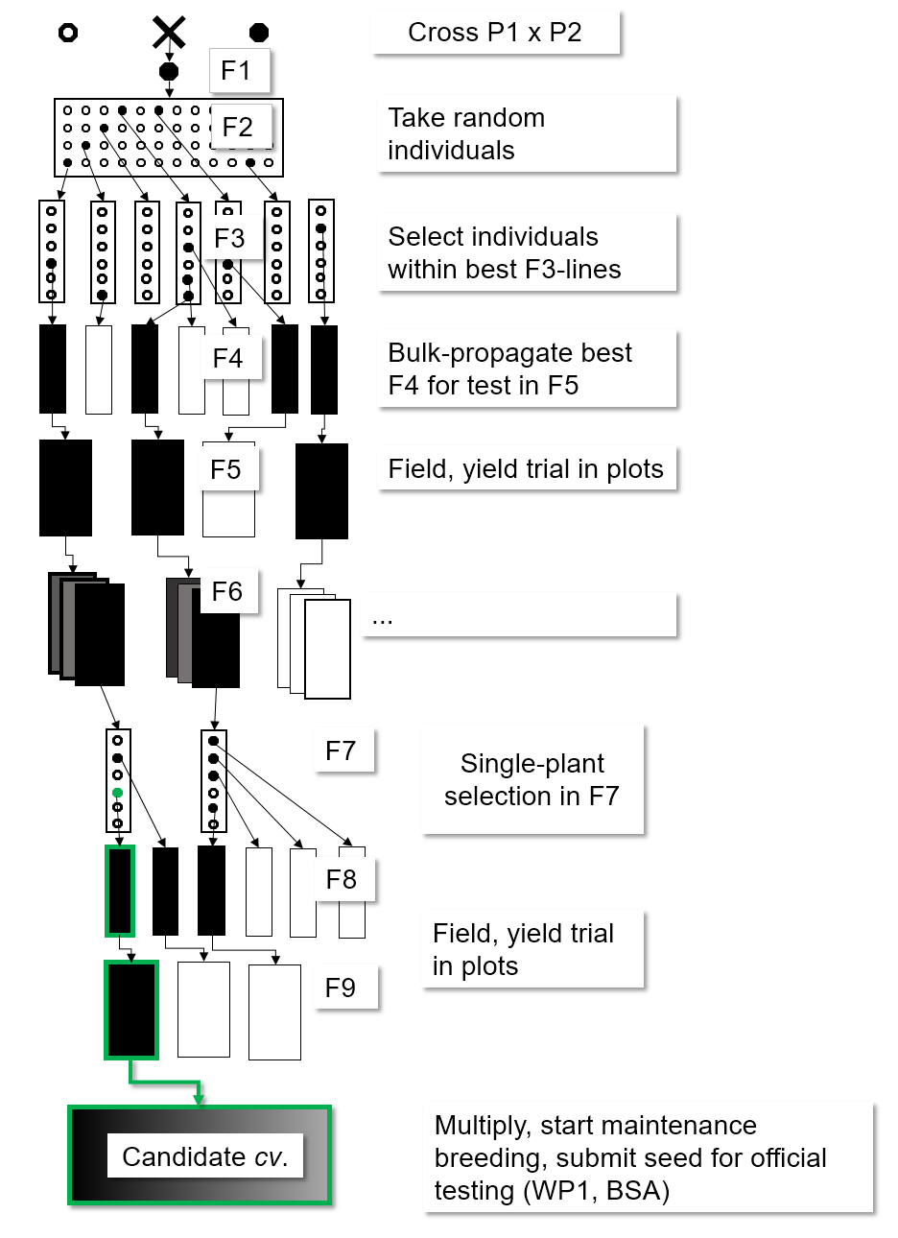
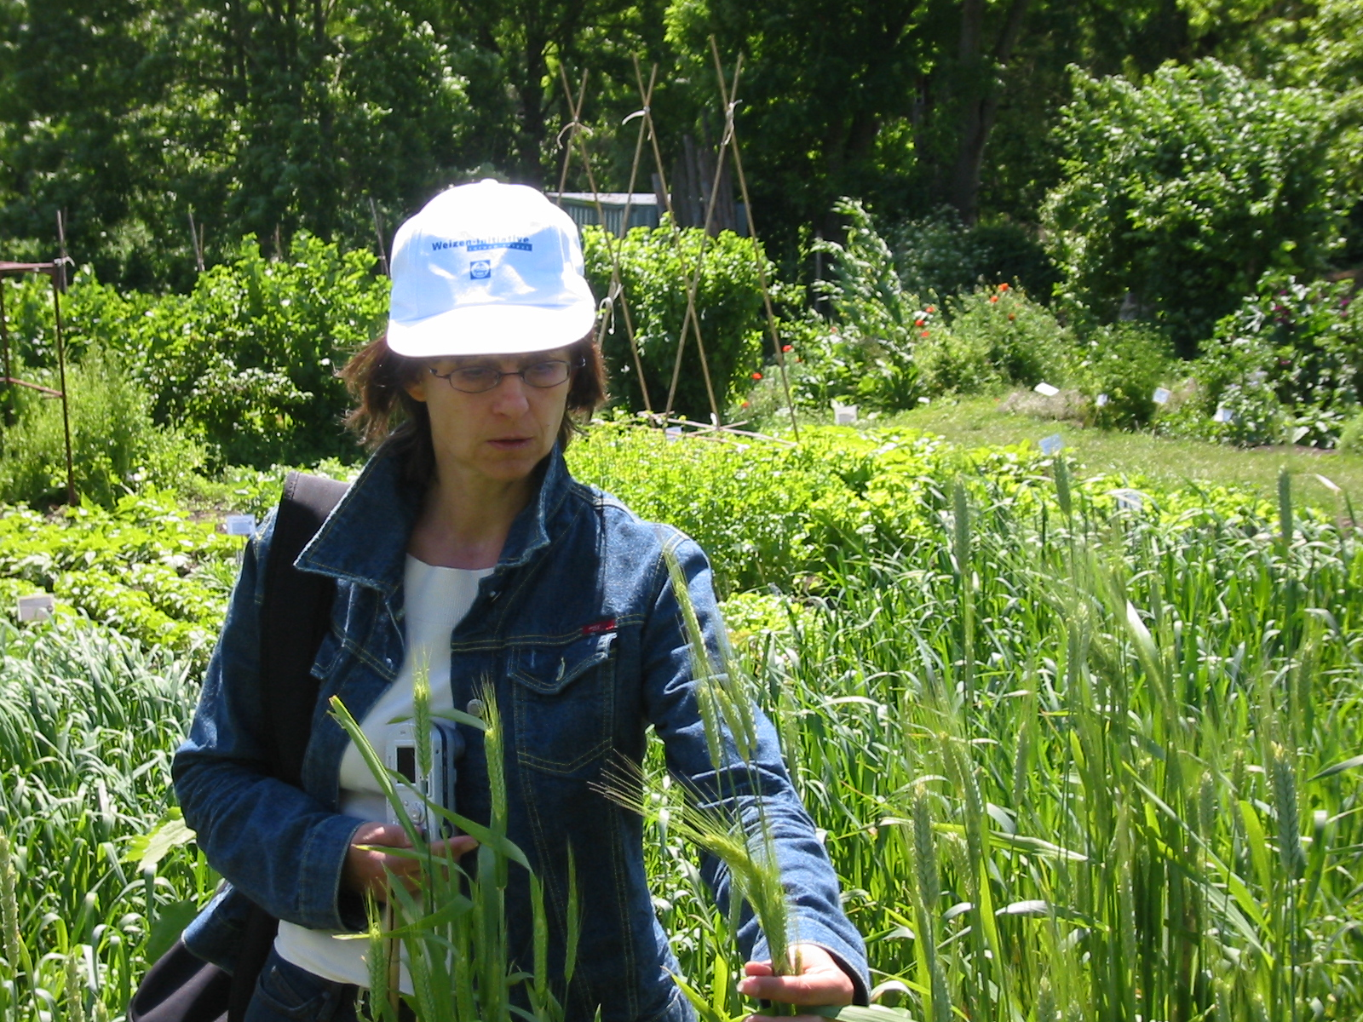
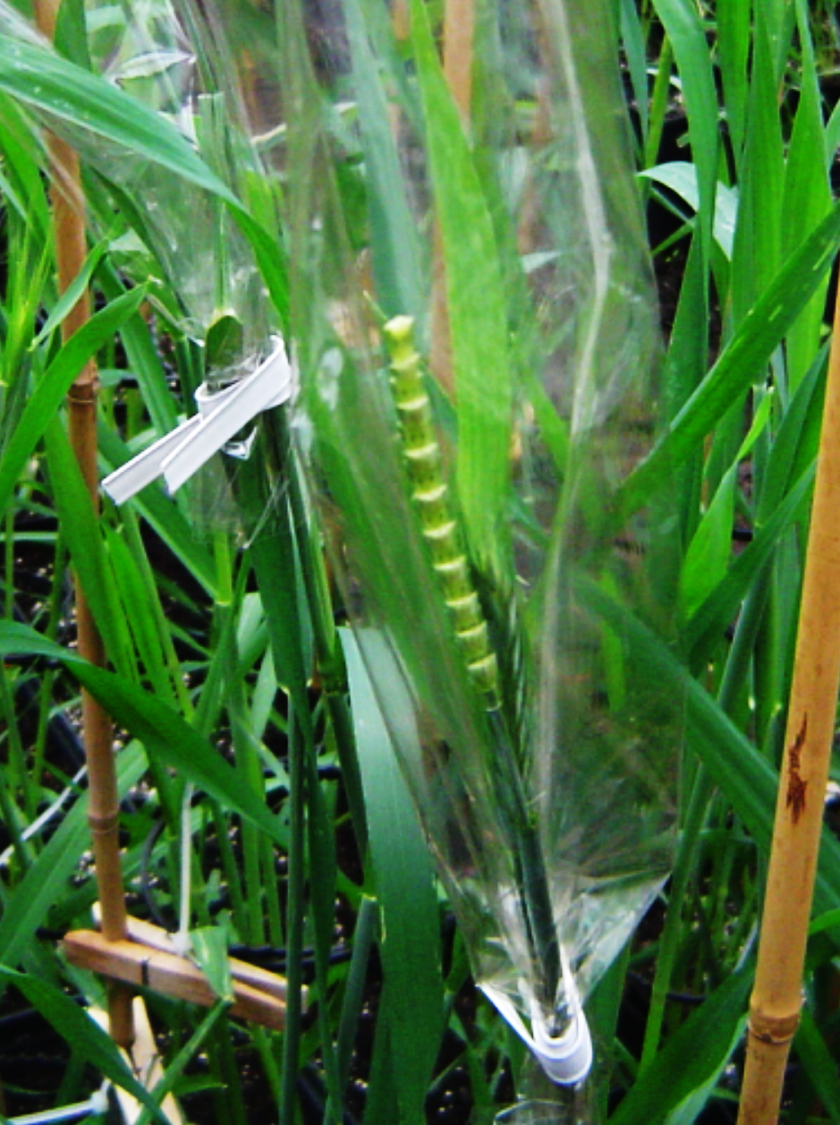
An now, which method is this? Breeders breed – they do not stick to the textbook text;-)
Emasculated wheat ear, ready for pollination.
© W. Link
9

Slide 10
Methodological research as topical item.
Luedders V.D. et al., 1973, Crop Science: Bulk, Pedigree, and Early Generation Testing Breeding Methods compared in soybeans. DOI: 10.2135/cropsci1973.0011183X001300030022xC
Bernardo, R., 2002, Crop Science: On the effectiveness of early generation selection in self-pollinated crops.
DOI: 10.2135/crop scie2003.1558
Dreisigacker et al. 2023 G3. DOI: 10.1093/g3journal/jkad025
Authors tested F2-individuals as F2:4 lines, i.e., they conducted yield tests (wheat) as early as possible.
Hassanpour, A., et al. 2026. DOI 10.1002/csc2.70294. … Optimization of wheat breeding programs ... algorithm ... resource allocation.
10

Slide 11
Single-Seed-Descent Method (Einkorn-Ramsch-Methode; Category of Line Breeding)
SSD lines (Single Seed Descent, Einkorn-Ramsch)
Per generation of selfing, from each plant (only) one seed is harvested (to approach homozygosity without selection). Advantage: Method can be per-formed under un-natural or artificial conditions (south hemisphere such as Chile; greenhouse; with >1 generations per year). Theoretically, Pedigree Selection may be more efficient than SSD: If favourable alleles are dominant and desirable genotypes can already be recognized if they are still (more or less) heterozygous (such as in F2, F3, F4; but see earlier discussions).
Yet, if favourable alleles show recessive gene action, then the identifiable de-sirable genotypes (those showing the desirable phenotype) are rare in these early generations and phenotypic selection will be more efficient later, among nearly or completely homozygous candidates. In SSD, there is no selection until the SSD-mode is abandoned and - after a first multiplication - line testing and selection is started. Then all good but as well all inferior types are still present. What a mishmash: A very strict selection must be applied then!
SSD Method allows speedy breeding if the crop flowers fast and sets seed fast – such as spring barley. SSD is less appealing if the crop needs a mar-ked phase of vernalisation thus the generation time can barely be accelerated (such as in winter canola, Brassica napus).
Single seed descent
F2
F3
F4
SSD
F5
SSD
F6
SSD
SSD
Start selection
11

Slide 12
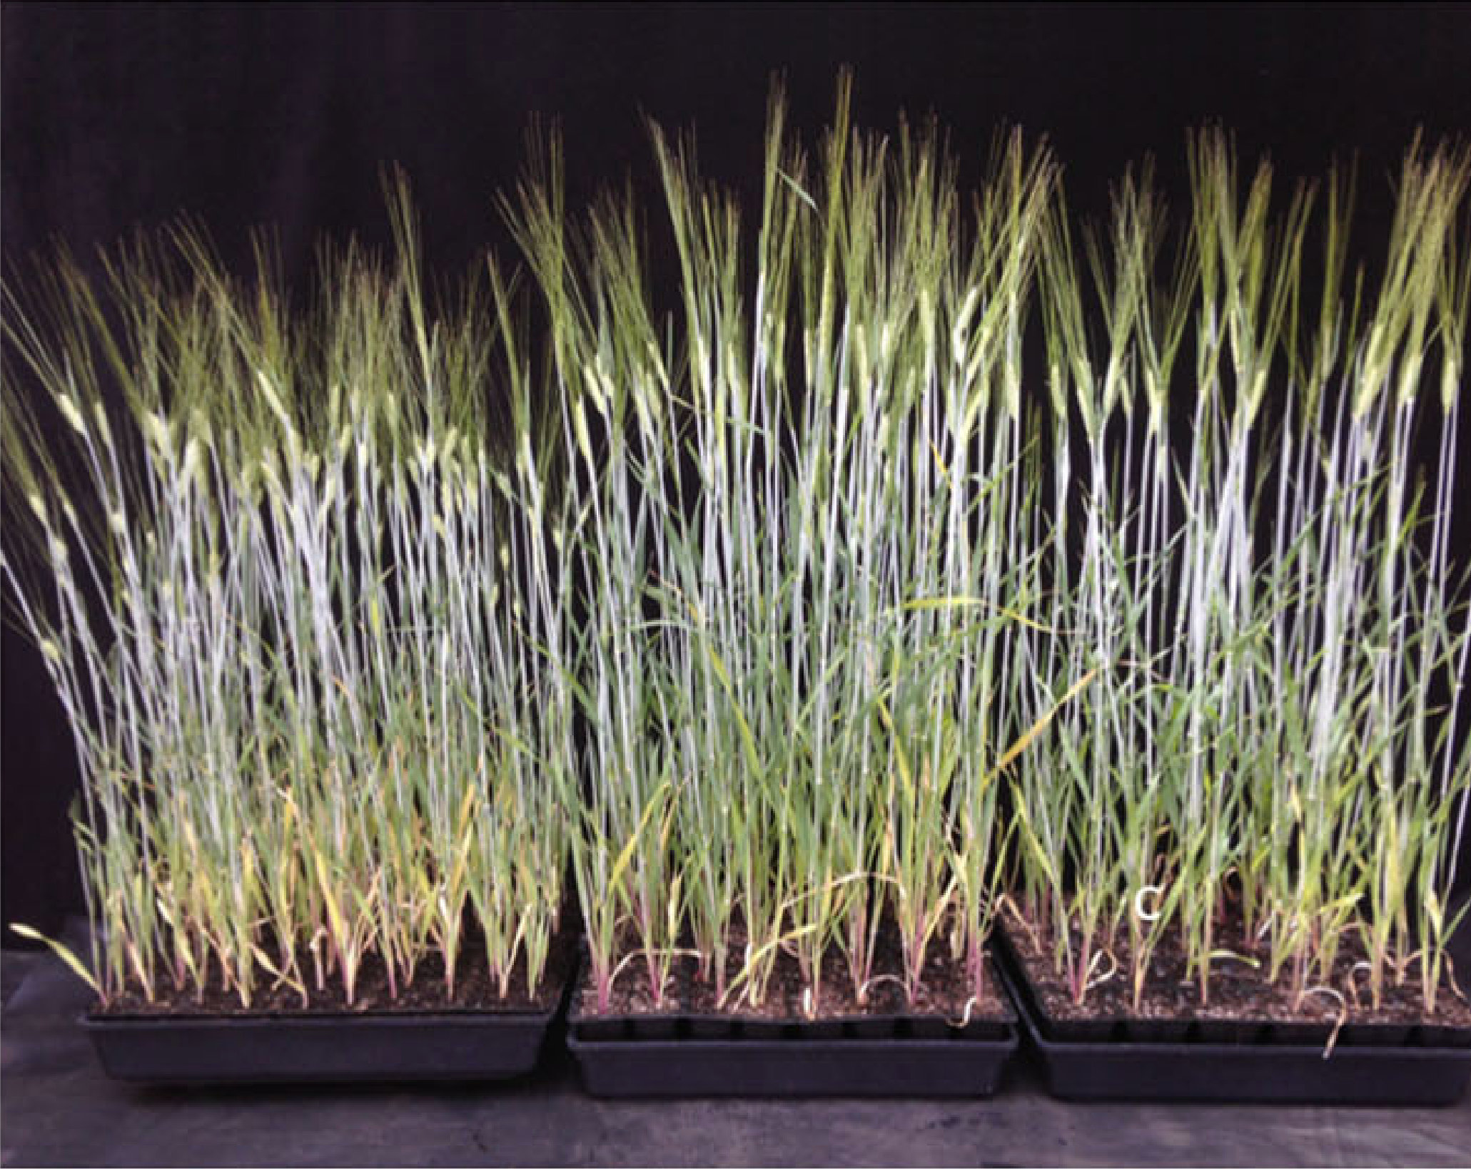
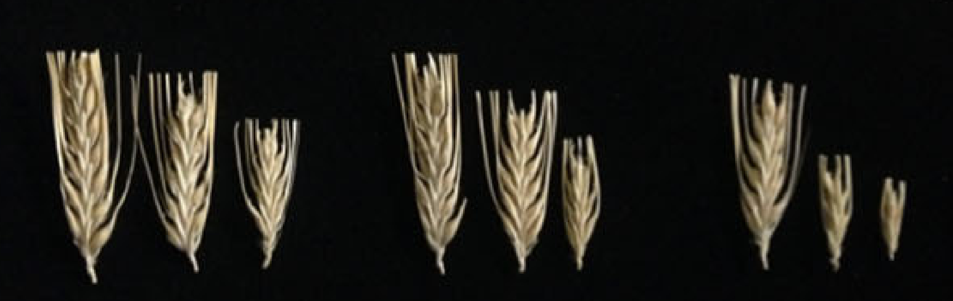
Single-Seed-Descent Method (Einkorn-Ramsch-Methode; Category of Line Breeding)
With one seed harvested per plant, the number of plants is constant across the selfing generations. Plants are pro-pagated in cheap, stressful, dense, harsh conditions and produce only few seeds per plant – one is enough ;-)
Single seed descent
F3
With LED-supplemented light, even ultra-dense growth in tiny pots (cells) is good-enough for SSD in e.g. barley. Ghosh, S., Watson, A., Gonzalez-Navarro, O.E. et al. Speed breeding in growth chambers and glasshouses for crop breeding and model plant research.
Nat Protoc 13, 2944–2963 (2018).
DOI 10.1038/s41596-018-0072-z.
SSD is especially attractive in species where no (efficient) DH-protocol is available. This is e.g. true for rye (Secale cereale; DOI: 10.1556/0806.46.2018.029).
12

Slide 13
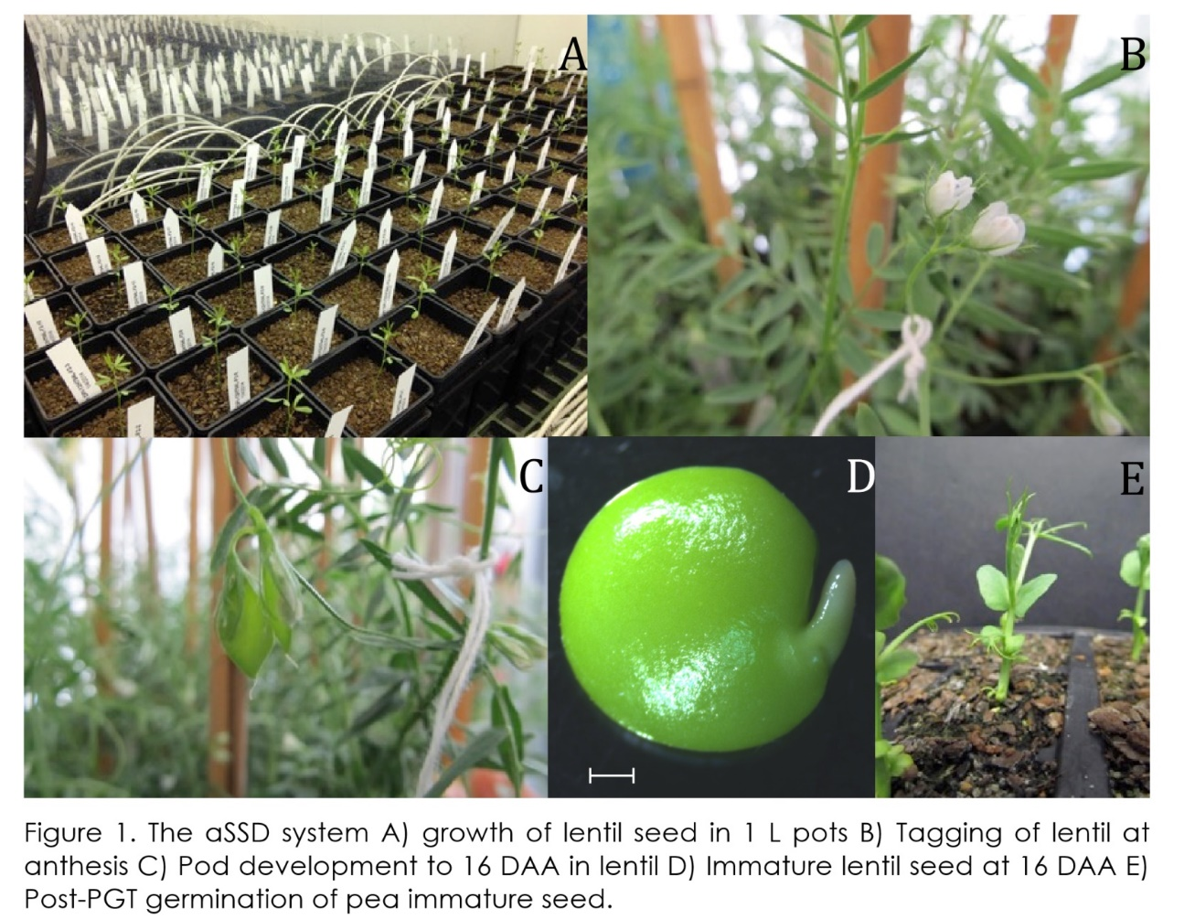
‘Speed Breeding’: Making haste. Ultrashort generations, early flowering, re-sowing of immature seeds. Speed-up SSD even more!
Ribalta et al., 2017: Precocious floral initiation and identification of exact timing of embryo physiological maturity facilitate germination of immature seeds to truncate the lifecycle of peas. Plant Growth Regul. 81, 345-353. DOI: 10.1007/s10725-016-0221-s
Mind: ‘Torturing’ plants is legal, unlike in animals ;-)
DAA = days after anthesis
aSSD = accelerated single seed descent
PGT = Precocious germination technology (PGT)
13
The aSSD system.
A) Growth of lentil seed in 1 L pots; B) Tagging of lentil at anthesis; C) Pod development to 16 days after anthesis in lentil; D) Immature lentil seed at 16 days after anthesis; E) Post PGT germination of immature seed.

Slide 14
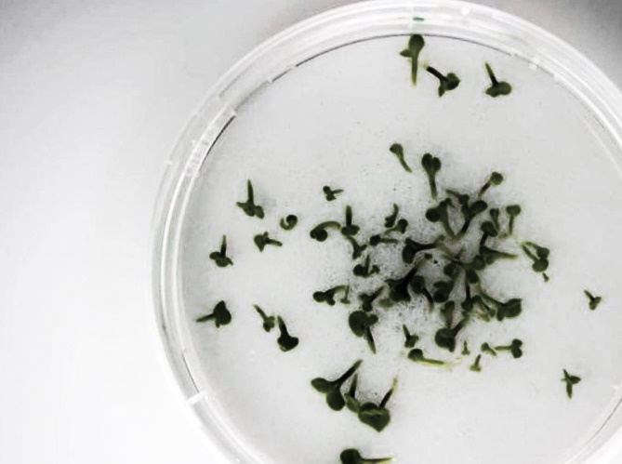
Doubled Haploid Method (DH; Doppel-Haploiden-Methode; Category of Line Breeding)
Diverse techniques lead to homo-zygosity in one step (‚homozygosity-to-go‘): Without the lengthy process along F1, F2, F3 etc. until F6 (or higher). One ap-proach is to start with gametes (immature pollen grains or imam-ture egg cells) and ‚convince‘ them (stress, hormones, light etc.) to abandon their development to-wards mature gametes and, in-stead, develop into haploid em-bryo-like beings; and eventually into plants. Still useless, weak, shaky plants. But ...
www.saaten-union-biotec.com
Have a Haploid.
Let it ‘double’. So:
Get a diploid
Done this way, this diploid
is homozygous
… after application of specific poison (Colchicine an the like), some haploids survive and will become diploid. Since their diploidy was created by ‚doubling‘ from haploidy, they then are 100% homo-zygous. Fully homozygous. Enforced homozygosity.
And that is the aim: ‚Have them homozygous - instantly‘.
homozygous
14

Slide 15
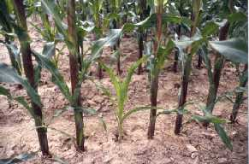
Doubled Haploid Method (DH; Doppel-Haploiden-Methode; Category of Line Breeding)
Diverse techniques lead to homo-zygosity in one step (‚homozygosity-to-go‘): Without the lengthy process along F1, F2, F3 etc. until F6 (or higher). One ap-proach is to start with gametes (immature pollen grains or imam-ture egg cells) and ‚convince‘ them (stress, hormones, light etc.) to abandon their development to-wards mature gametes and, in-stead, develop into haploid em-bryo-like beings; and eventually into plants. Still useless, weak, shaky plants. But ...
Cross parents
F1
Go directly from F1 to homozygosity (DH technology)
F∞≙DH
www.saaten-union-biotec.com
Select among DH lines
Select among DH lines
!
Select among DH lines
… after application of specific poison (Colchicine an the like), some haploids survive and will become diploid. Since their diploidy was created by ‚doubling‘ from haploidy, they then are 100% homo-zygous. Fully homozygous. Enforced homozygosity.
And that is the aim: ‚Have them homozygous - instantly‘.
Experimental cultivar
15

Slide 16
Doubled Haploid Method (DH; Doppel-Haploiden-Methode; Category of Line Breeding)
A major difference between ‘homozygosity in one step’ and ‘homozygosity through several generations of selfing’ is: With DH, there was only one Meiosis: The Meiosis of the F1-plant when it produced its gametes. This may be relevant if linkage is considered.
In maize, there is an alternative DH technique. Upon pollination with pollen from specific genotypes (‚inducers‘), a minority of seed is not really crossed but contains a haploid embryo (from egg cell).
Cross parents
F1
Go directly from F1 to homozygosity (DH technology)
F∞≙DH
www.saaten-union-biotec.com
Select DH lines
Select DH lines
Select DH lines
These haploids then grow into - again - slim and weak plants. Either spontaneously or after treatment with e.g. Colchicine, they ‚double up‘ and become: Diploid which means homozygous.
Pollinating wheat flowers with maize pollen or barley (Hordeum vulgare) flowers with pollen of Hordeum bulbosem can have such out-come. Other examples of the inducer approach exist.
Experimental cultivar
Would you call the initial, single, unique homozygous DH plant a ‘line’?
16

Slide 17
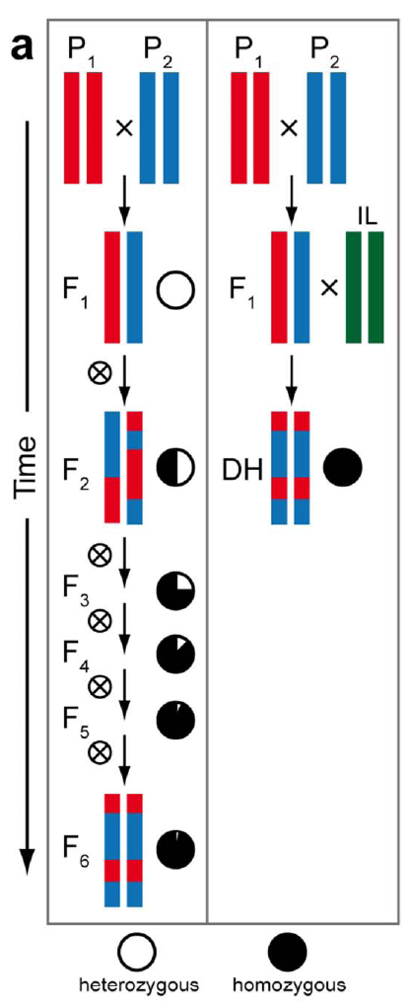
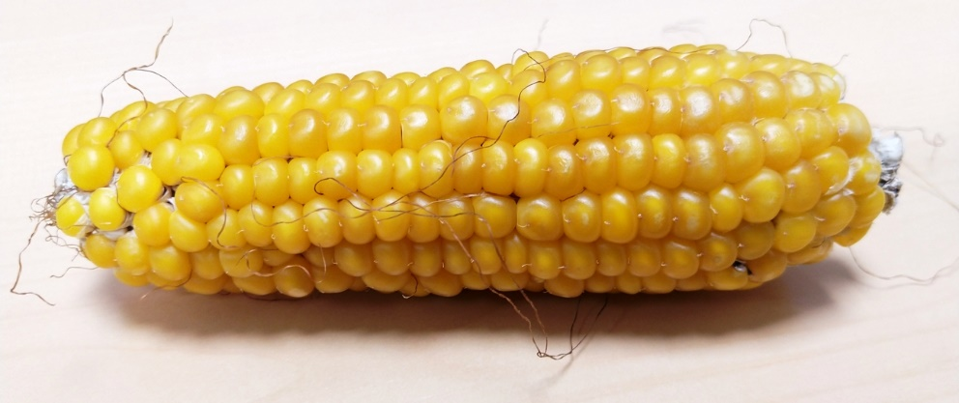
F1 as donors of segregating gametes, which turn into DHs. The DH-indivi-
duals ‘are’ just like *RILs (RILS: the lines that can be bred from the F1).
When employing a so-called inducer-genotype to induce the formation of haploid offspring, then such inducer does not contribute genes to the offspring and does not participate in the segregation of such offspring.
The left part of the left diagram is the conventional, slow way towards homozygosity. As you see in the right part of the diagram, there are two crosses “x” to be conducted.
Homozygosity
-To-Go
The second cross is ‚just‘ to induce as many as possible kernels with haploid embryos, which, upon sowing, develop into haploid plants. These then have ‚only‘ to be convinced to become di-ploid, this step then makes them homozygous automatically. Haploid kernels are, alas, rare.
© wlink
Non-inbred, highly heterozygous
*the panel of all lines that can be developed from a cross via series of selfing is often called RIL: ‘Recombinant Inbred Lines’.
Inbred, homozygous
Melchinger et al. 2013 doi.org/10.1038/srep02129
17

Slide 18
Donors of such female gametes should be F1; to realize & exploit segregation. The DHs then are like the sum of all lines that could have been bred conventionally from the F1.
When employing a so-called inducer-genotype to induce the formation of haploid offspring, then such inducer does not contribute genes to the offspring and does not participate in the segregation of such offspring.
The left part of the diagram is the conventional, slow way towards homozygosity. As you see in the right part of the diagram, there are two crosses “x” to be conducted: The genuine cross for breeding purposes, to create better offspring (combine favourable features from P1 and P2); and the second cross with the inducer line IL. This second cross (‘pollination’) is meant to induce the formation of haploid plants from the segregating female gametes of the F1 (is meant to get one homozygous DH-plant per involved female gamete; either spontaneously or by applying poisonous chemicals such as Cholchicine).
There are specific approaches to identify those rare seed which have the desired haploid embryos (<10%) – even before sowing – when still sitting on the ‘induced’ maize cobs in middle of the majority of kernels which are ‘true’ crosses between mother F1[P1 x P2] and the inducer. After sowing all seed, they can ‘anyway’ be identified by their weak growth.
Non-inbred, highly heterozygous
Inbred, homozygous
Melchinger et al. 2013 doi.org/10.1038/srep02129
18

Slide 19
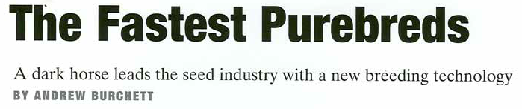

A major break-through: Instant-homozygotes from maize crosses for speedy breeding
At the University of Hohenheim, the teams of Hartwig Geiger and Albrecht Melchinger were driving forces behind this development.
Farm Journal, from AgReliant 2004
19
ChatGPT‘s ‚dynamic black horse‘; the movement of the dust is dynamic in-deed, but difficult to realise in the real world. If the horse braked in this way, it would immediately have to fall forwards in a very blatant way.
Melchinger et al., 2013. Scientific Reports. Rapid and accurate identification of in vivo-induced haploid seeds based on oil content in maize. DOI 10.1038/srep02129.
The DH technique leads to an instant type of homozygosity, which means instant creation of true-to-type breeding seeds. Moreover, it leads to instant release of all additive genetic variance plus additive-types of epistatic diversity, accessible for phenotype- and genotype-based selection. Instantly, all such genetic variance is shuffled from within-family and within genotype to between candidates ... where it then can be exploited for breeding.
Draw-back: With only one meiosis, unfortunate linkage is poorly resolved; in such case not all potential combinations and epistatic effects will be accessible for selection.
Deimling, Röber, Geiger, 1997: Methodik und Genetik der in-vivo Haploideninduktion bei Mais. (Methodo-logy and genetics of the in-vivo haploid induction in maize). Vorträge für Pflanzenzüchtung 353: 225-226. ISSN 0723-7812

Slide 20
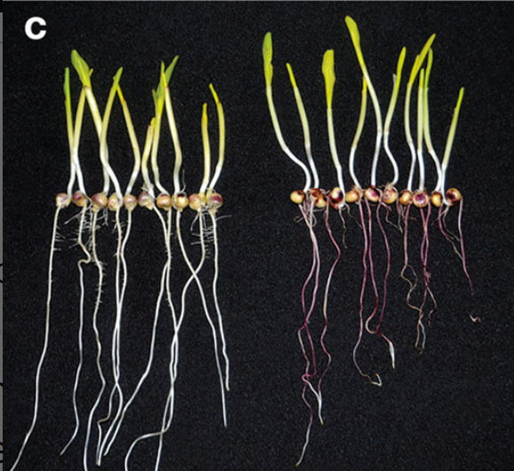

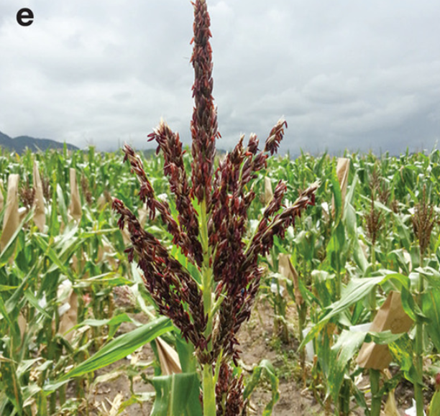
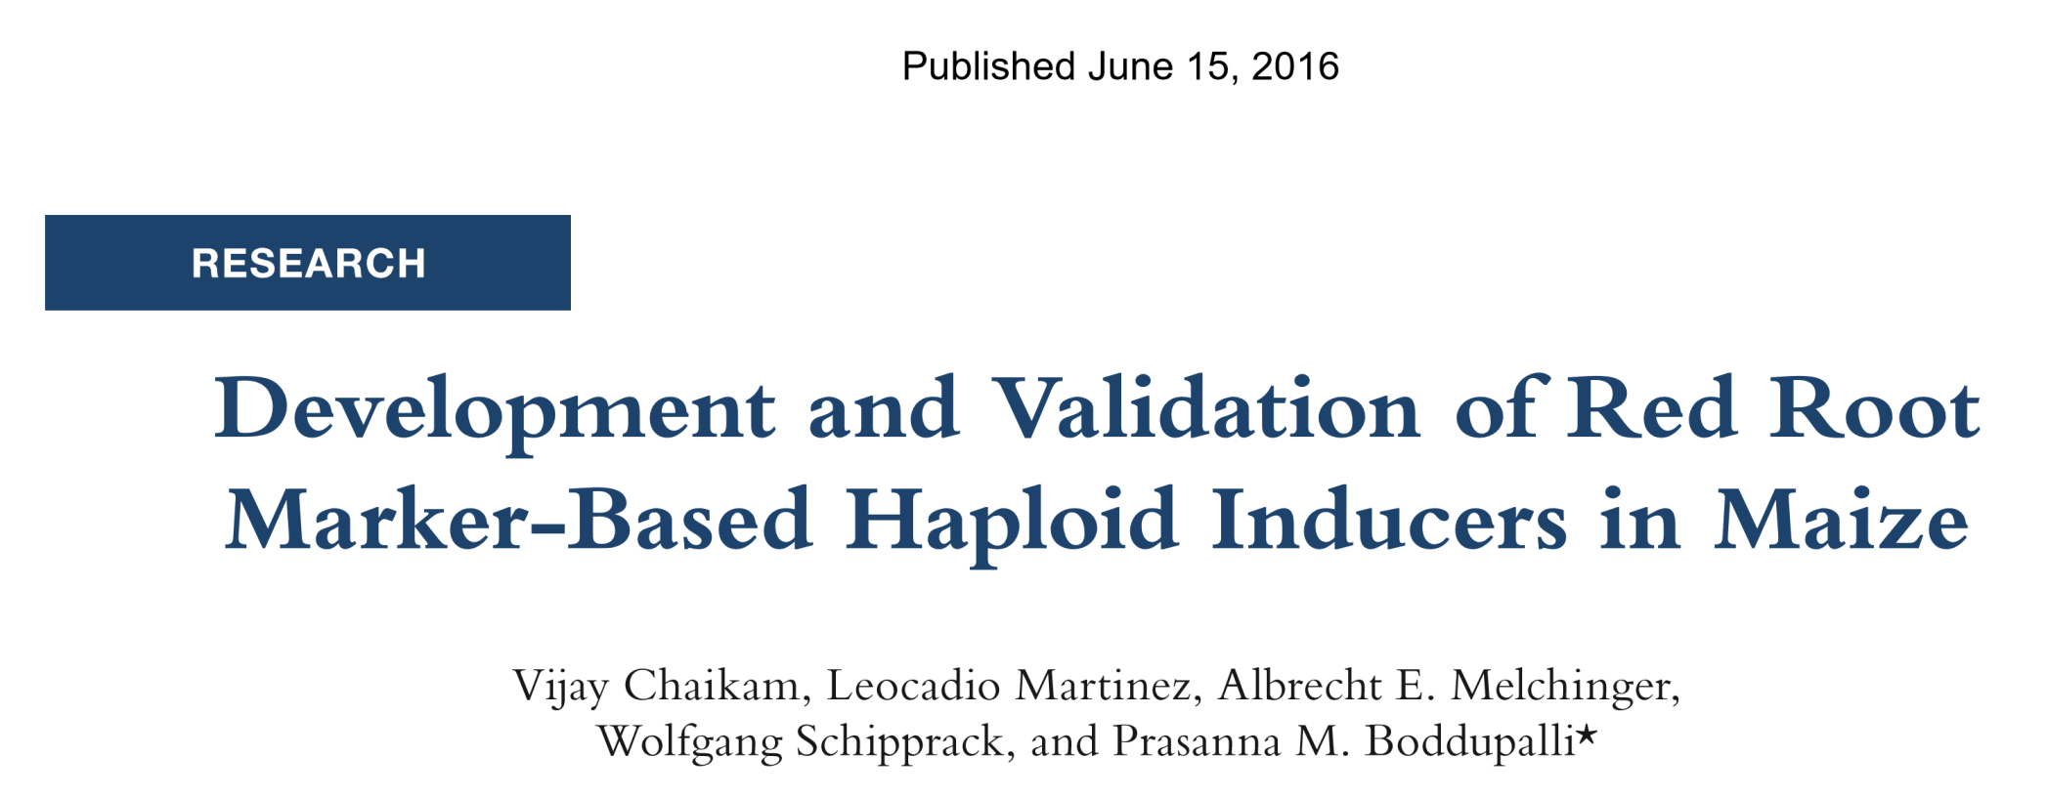
A major break-through: Instant-homozygotes from maize crosses for speedy breeding
„Dark horse“ means „Unexpected winner“; „Aussenseiter“ , „Unbeschriebenes Blatt“.
Farm Journal, from AgReliant 2004
Preferentially inducers with clear, dominant expressions of monogenic traits (root colour, tassel colour) are employed to filter against the ‘true’ crosses with inducers (identify the haploids)
Doubled Haploids: A simple method to improve efficiency of maize breeding – YouTube
https://www.youtube.com/watch?v=V2jOEuZjjrg
20

Slide 21
DH-Techniques in vitro (petri dish, tissue culture)
Anther- or microspore culture (e.g. in rapeseed, barley)
Gynogenesis induction (via female gametes, i.e. culture of isolated unfertilized ovules; e.g. sugar beet)
DH Techniques in vivo (more acceptable for organic breeders)
Pollination with related species (barley, wheat)
Pollination with inducer line (maize)
21

Slide 22
Ponder three Methods from the Category of Line Breeding. What considerations and arguments can be made in favour of which Method?
What if yield is the most important trait?
What if crosses are distant (with exotic parents)?
In the three other Categories of Plant Breeding, we will not analyse that many Methods ;-)
Petridish / Inducer
DHs
Bulk
F₂
Homozygous!
~Homozygous
Rather homozygous
22

Slide 23
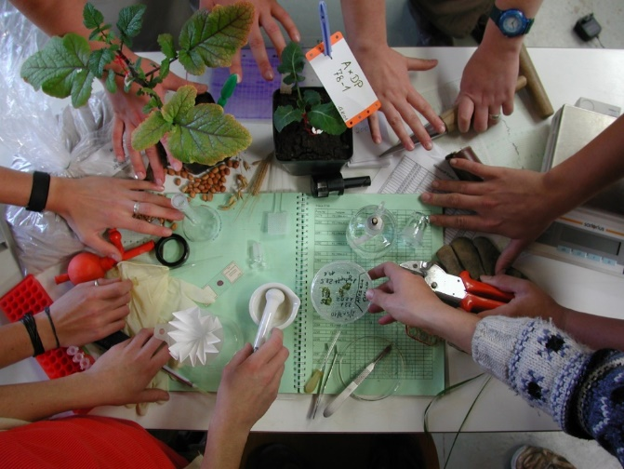
Volumes depend on Methods: If (as is true in the SSD Method) you do not kick out (bad) material early (before it becomes homozygous), you have a lot of (unsatisfying) material entering the later, expen-sive field test phase.
Pedigree Method
DH-Method
DHs
F₂
Selection is based on both, phenotypic data and DNA information of candidates (so-called ‘genotyped’ candidates). If DNA-based selec-tion is efficient and cheap, then inferior types can be removed before they are (diploidised and) propagated and tested in the field (money, time).
Plant Breeding
Methodology conti-
nues to evolve .
Homozygous!
Rather homozygous
© SY
23

Slide 24
From here you may go to UNPLAB-BrMeth_Ch-10[TheFour III]
24
24

